Slide 1

Bank Loan Case Study
By: Rajat Panwan

Slide 2

Project Description:
The project aims to use exploratory data analysis (EDA) to analyze loan application data and identify patterns that indicate if a client has difficulty paying their installments. The project aims to understand the driving factors behind loan default, i.e. the variables which are strong indicators of default, and utilize this knowledge for the company's portfolio and risk assessment.

Slide 3
Tech-Stack Used:
The project was performed using Excel version 2021 Excel was chosen for its powerful data analysis and visualization capabilities It is also widely used in the industry and provides a familiar environment for users.

Slide 4
Insights:
The mean income for the income is around 160000.
There is something wrong in the data the mean of the days_employeed in not acceptable.
8 percent people have difficulties in payments.
It show that Amt_Goods_Price and Amt_Credit are the most correlated variable followed by Amt_Annuity & Amt_Goods_price and Amt_Credit & Amt_Annuity.
Although Females are more difficulties with payment but percentage wise it is male who face difficulties in payments.
Here are more females than males. The ratio of male and female in around 1:2.
The average of the income for male is more as compared to female.
Academic degree holder apply for the loan most.
Academic degree holder ask for more credit as compare to other educational background.
Male ask for greater money for loan as compare to the female.

Slide 5
Result:
Through this project, I was able to gain valuable insights into the factors that influence loan default and develop a basic understanding of risk analytics in the banking and financial services sector. What I find is on next pages.

Slide 6

Present the overall approach of the analysis. Mention the problem statement and the analysis approach briefly
The project was executed by first performing data cleaning and preprocessing, followed by exploratory data analysis (EDA). During EDA, various statistical and visualization techniques were used to gain insights into the data and identify patterns related to loan default. The data was also analyzed in conjunction with the data dictionary and domain research on risk analytics.

Slide 7
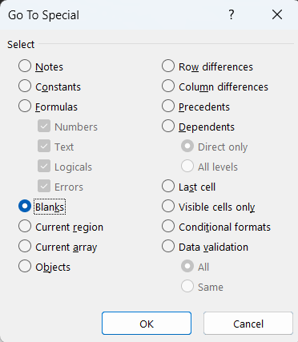
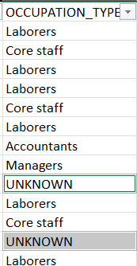
Identify the missing data and use appropriate method to deal with it. (Remove columns/or replace it with an appropriate value):
Delete the row which has blank vlues.
In some column such as occupation_type with blank values in replaced with unkown.
Delete some columns which is not required in the analysis.

Slide 8
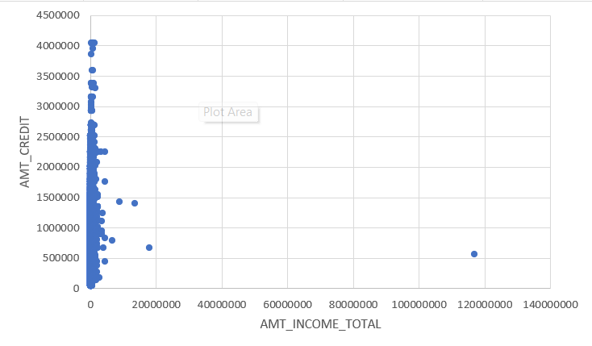
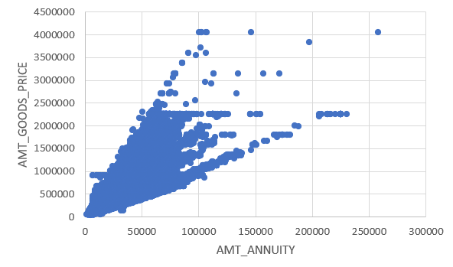
Identify if there are outliers in the dataset. Also, mention why do you think it is an outlier:
SK_ID_CURR 114967 is the outlier because his credit is very less as compare to his income.
In second graph SK_ID_CURR 120926 is the outlier with respect to amount goods price and amount annuity.
Scatter Plot is used for getting the outliers.

Slide 9
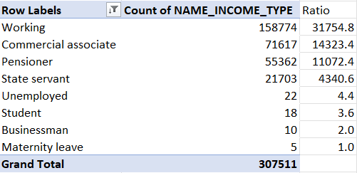
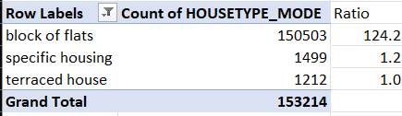
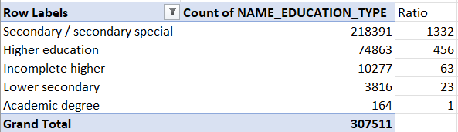
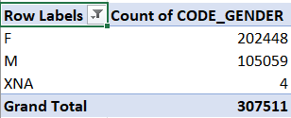
Identify if there is data imbalance in the data. Find the ratio of data imbalance:
Pivot table is used for checking the data imbalance. Here data is imbalanced as most of the data is from the working Income Type where as very less for business. The ration for working and business income type is 31000:2
Here data is imbalanced because most of the House type is block of flats and others are very less. The ratio of block of flats and other house type is 124:2
Here data is imbalanced because most of the data is has education type and very less for academic degree their ratio is 1332:1
Here are more females than males. The ratio of male and female in around 1:2.

Slide 10
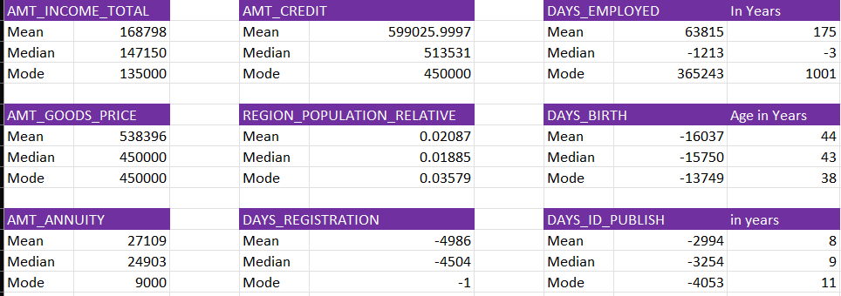



Explain the results of univariate, segmented univariate, bivariate analysis, etc. in business terms:
Univariate:
In first table AMT_INCOME_TATAL mean is amount 168798 , median is 147150 where as mode is 135000
In second table AMT_CREDIT mean is amount 599025, median is 513531 and mode is 450000.
In DAYS_EMPLOYED mean is 175 years and mode is 1001 years which not acceptable as data.
These three formulae are used for the univariate Analysis.
In Days_Employed Column there is some mistake in data because mean of the is 174 years which is wrong and mode is 1001 years when days are converted into years.

Slide 11
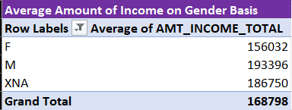
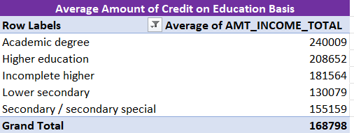
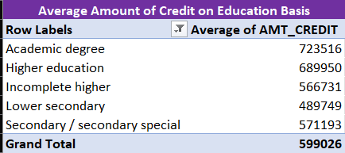
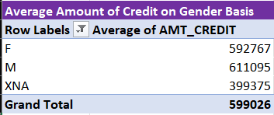
Explain the results of univariate, segmented univariate, bivariate analysis, etc. in business terms:
Segmented Univariate:
The average of the income for male is more as compared to female.
Academic degree holder apply for the loan most.
Academic degree holder ask for more credit as compare to other educational background.
Male ask for greater money for loan as compare to the female.

Slide 12
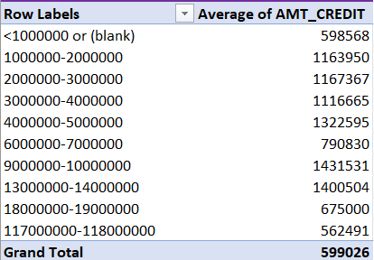
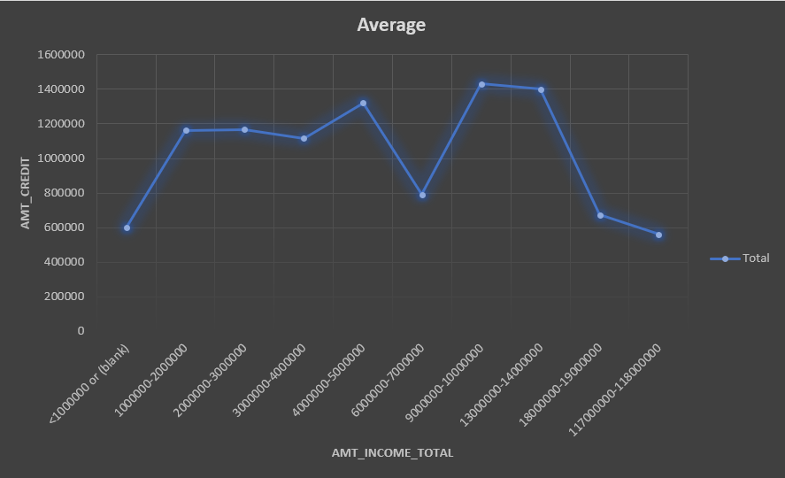
Explain the results of univariate, segmented univariate, bivariate analysis, etc. in business terms:
Bivariate Analysis (Part-1):
This is Bivariate Analysis because it show how the one parameter is behave with the change in other.
The adjacent line graph show that people with income 9000000 to 14000000 is ask for more loan.
Where as income between 6000000 to 7000000 is lesser than the nearest income class.

Slide 13
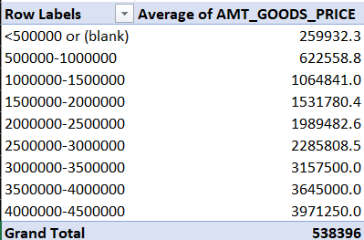
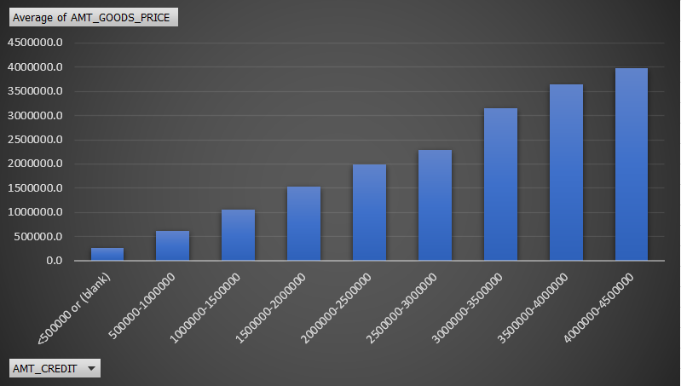
Explain the results of univariate, segmented univariate, bivariate analysis, etc. in business terms:
Bivariate Analysis (Part-2):
The adjacent bar graph show that Credit amount is increases with the increase of Good Price.

Slide 14
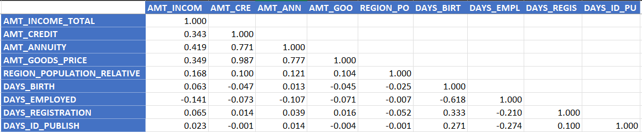
Find the top 10 correlation for the Clients other than payment difficulties:
This is the correlation matrix for clients other than payment difficulties.
It show that Amt_Goods_Price and Amt_Credit are the most correlated variable followed by Amt_Annuity & Amt_Goods_price and Amt_Credit & Amt_Annuity.

Slide 15
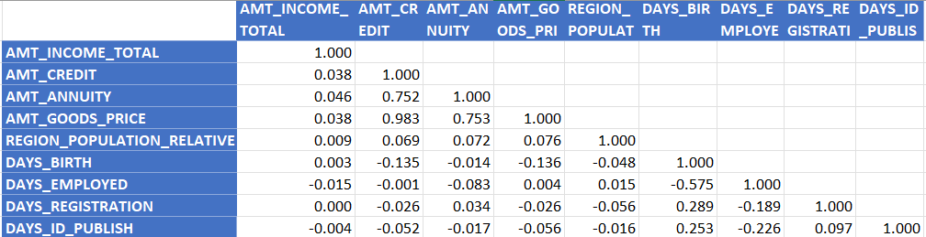
Find the top 10 correlation for the Client with payment difficulties:
This is the correlation matrix for clients with payment difficulties.
It show that Amt_Goods_Price and Amt_Credit are the most correlated variable followed by Amt_Annuity & Amt_Goods_price and Amt_Credit & Amt_Annuity.

Slide 16
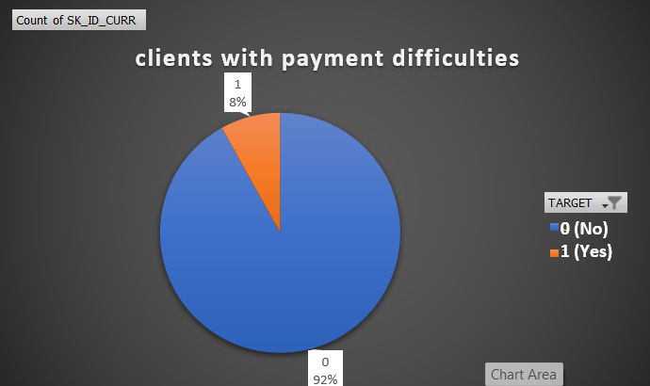
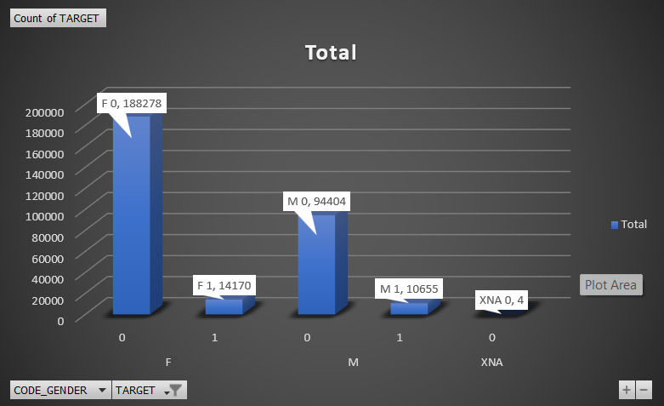
Include visualizations and summarize the most important results in the presentation:
In above pie chart we can see that on 8% of clients have payments difficulties.
According to the above graph it is shown that although Females are more difficulties with payment but percentage wise it is male who face difficulties in payments.

Slide 17
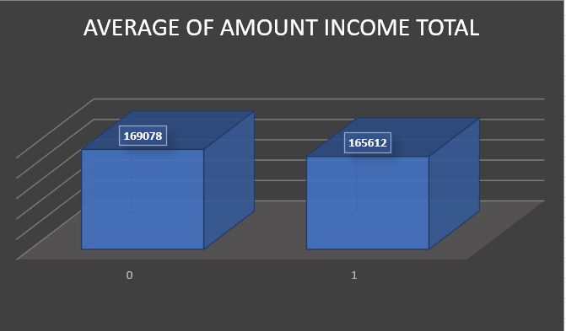
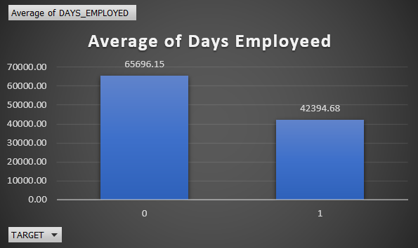
Include visualizations and summarize the most important results in the presentation
In above bar chart it can be seen that client with payment difficulties and other clients have almost same income amount.
In above bar chart it can be seen that client with payment difficulties has lesser number of days employeed.

Slide 18




THANK YOU!
Rajat Panwan
rajatpawan@gmail.com
9457941019

